Slide 1
Financial Risk Analysis
Team 9
Balamanikandan Gopalakrishnan
Rachan Hegde

Slide 2
Agenda
Problem Statement
Data Set
Approach
Prediction – Impacted Stocks, VAR

Slide 3
Problem Statement
Estimate the VAR (Value at Risk) associated with the given portfolio of stocks for a specific time period. Also provide insights on the stocks that are most impacted during this time frame

Slide 4
Dataset
Portfolio of 3000 Stocks
Open, Close, High, Low, Volume and Adj Close
These values are captured on a daily basis
Market factors (S&P 500, NASDAQ, Bonds, Oil)
~ 9 Million Records

Slide 5
Additional Information
The value of stocks are impacted by external factors (S&P 500, NASDAQ, Bonds, Oil)
Financial Risk Analysis
Estimate the factor co-efficient associated with each of the stock by using the historical data
Using Monte Carlo simulation, estimate these external factors
Compute the VAR using estimated external factors and stock co-efficient

Slide 6
Environment Used
Amazon EMR v3.8
1 Master mx3 large instances
4 Slaves mx3 large instances
Spark 1.3.1
Hue 0.17
Hive
Apache Zeppelin Bootstrapped
Tableau

Slide 7
Approach
1. Load Data
2. Data Analysis
3. Data Preprocessing
4. Data Transformation
5. Predict co-efficient for stocks
6. Simulate External Factors
7. Estimate VAR
8. Summarization
Hive
Hue
Zepplin
Spark – Mlib Regression Algorithms
Tableau
Spark - Using predictions from 6 & 7
Spark - Multivariate Normal Distribution
Spark
Tableau
Spark
Hue

Slide 8
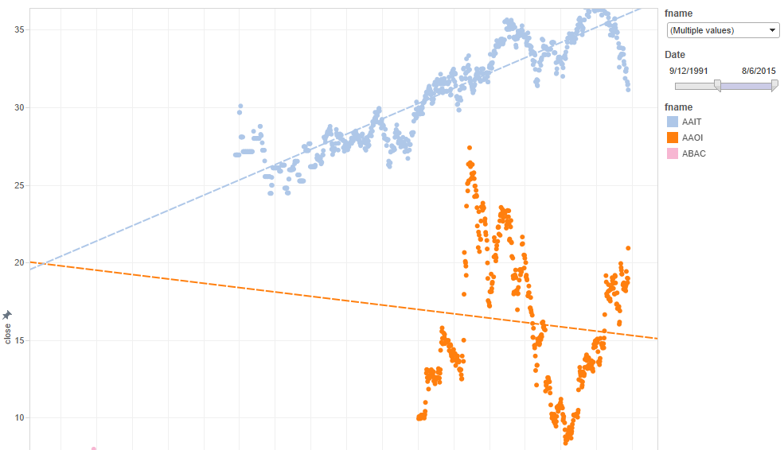
Data Analysis – Missing Data Handling
Note: The missing data was filled with observations from nearest neighbor as latest records are more relevant in time series data that using mean.

Slide 9
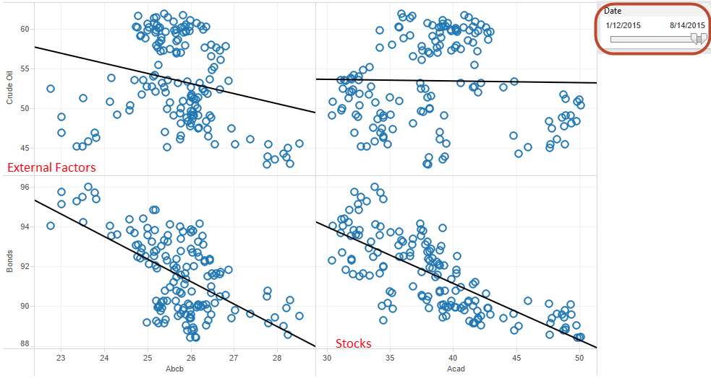
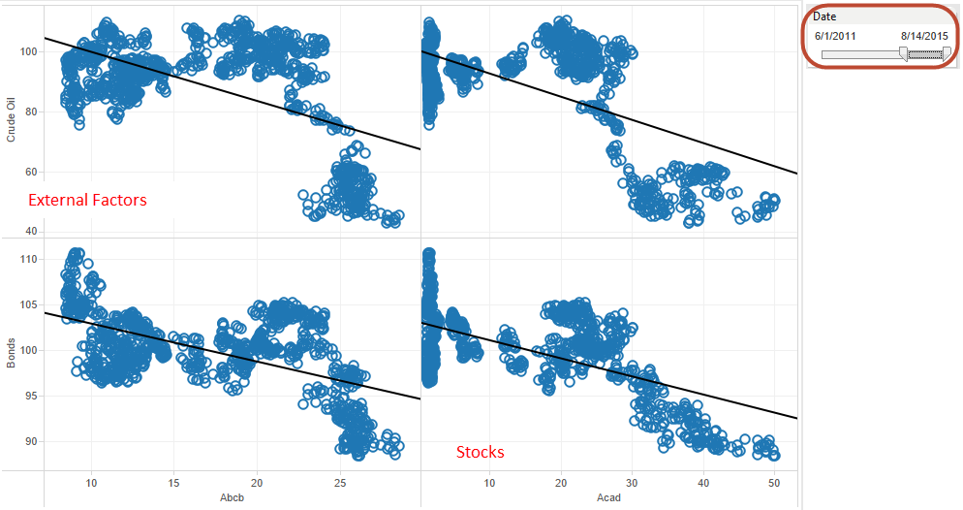
Data Analysis – Correlation
Note: It was observed that there was no direct relationship between stocks and external factors as they vary across time

Slide 10
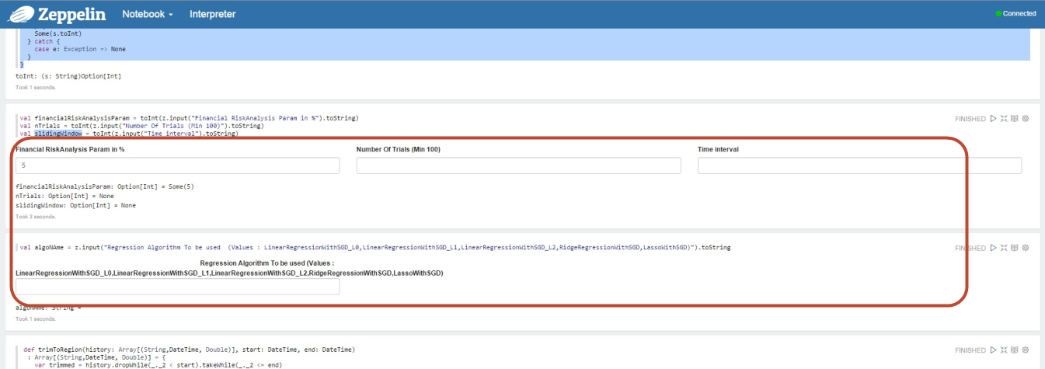
Zeppelin – Dynamic Form

Slide 11
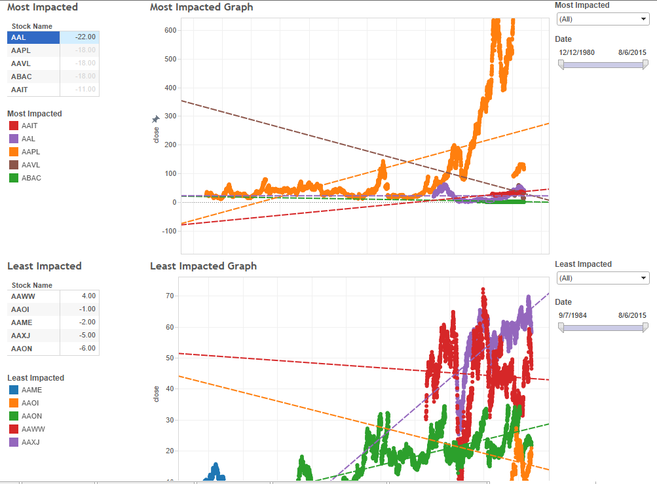
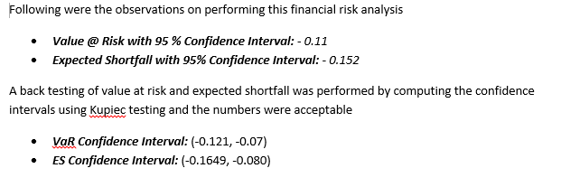
Prediction – Impacted Stocks

Slide 12
Thanks !!!

